Slide 1
Asteroid Blast
By Sam Wang and Nate Mustafa

Slide 2
Rules/Instructions
You are a spaceship that is trying to survive in outerspace by destroying the asteroids that may hit you.
Use the left and right arrows to rotate left and right and use the up and down arrow keys to move forward and backward
Use the spacebar to shoot asteroids but watch out! These asteroids will split into two smaller asteroids when destroyed that move even faster than the original asteroid
Aliens will also appear. They each have two lives and bounce around the screen. These aliens will shoot back at the player, so if the player gets hit, it loses a life.

Slide 3
Main Levels
Level 1: Four asteroids will spawn. The Player needs to destroy all the asteroids, including the split asteroids, in order to complete the level.
Level 2: Four alien spaceships will spawn. The aliens will shoot at the Player to try and kill it. The Player must destroy all the aliens, which have 2 lives each, in order to complete the level
Level 3: A boss alien will appear, along with multiple asteroids. Every 10 seconds, an alien will spawn out of the boss alien. The boss alien has a health bar and the Player must defeat it to finish the game

Slide 4
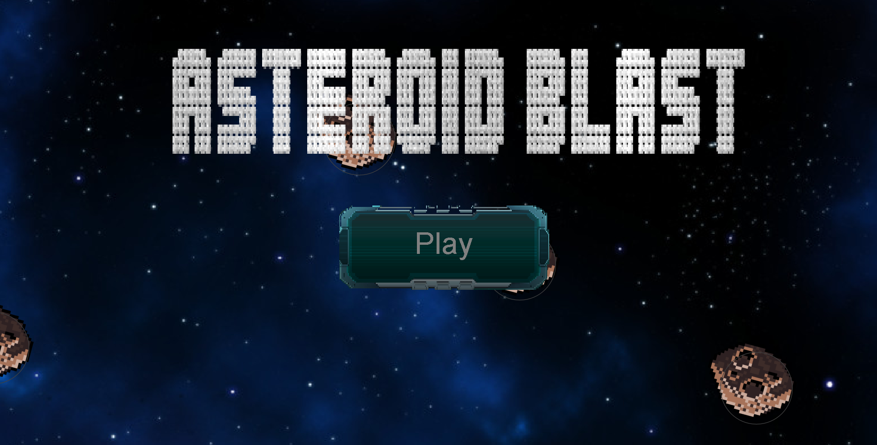
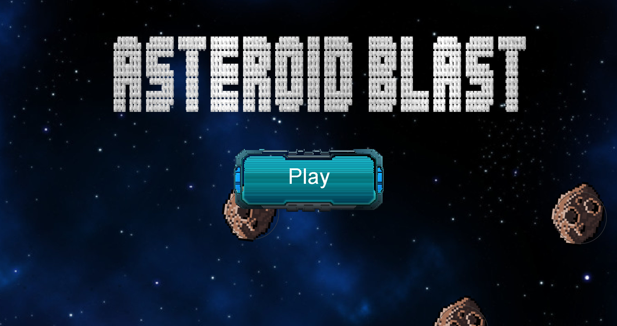
Main Page

Slide 5
How we created buttons
switch (HomePage.mode) { case 0: { game.setVisible(false); game.setFocusable(false); homePage.setVisible(true); homePage.setFocusable(true); homePage.requestFocus(); break; } case 1: { homePage.setVisible(false); homePage.setFocusable(false); //add(game); game.setVisible(true); game.setFocusable(true); game.requestFocus(); break; } }
To create the buttons, we implemented MouseMotionListener to track the location of the mouse at all times. When the mouse is within a certain area, we draw a different image to let the user know they are hovering over the button. When the button is clicked, using a switch statement, we change which Component is set visible to the user.
if(mouseX>570&&mouseX<920&&mouseY>340&&mouseY<490) { g.setColor(Color.WHITE); g.drawImage(lightbutton,567,345,350,150,null); } else { g.drawImage(darkbutton, 570, 340, 350, 150, null); g.setColor(Color.GRAY); }

Slide 6
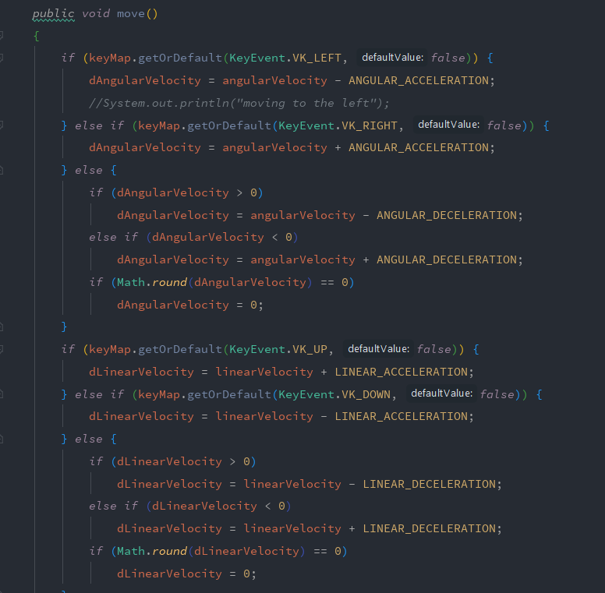
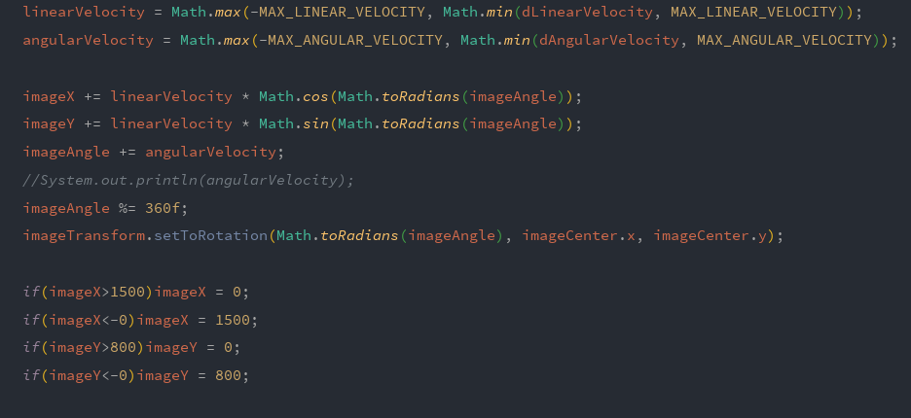
Movement Code

Slide 7
Movement Code Explained
In order to accurately simulate space movement, we had the player constantly be moving at a speed of linearVelocity. However, linearVelocity starts off at 0. When a key is pressed, it is increased exponentially to simulate acceleration. Furthermore, we set a maximum for linearVelocity so the ship would not be able to move too fast. When the key is let go, the linearVelocity decreases at a exponential rate back to 0 to simulate deceleration.

Slide 8
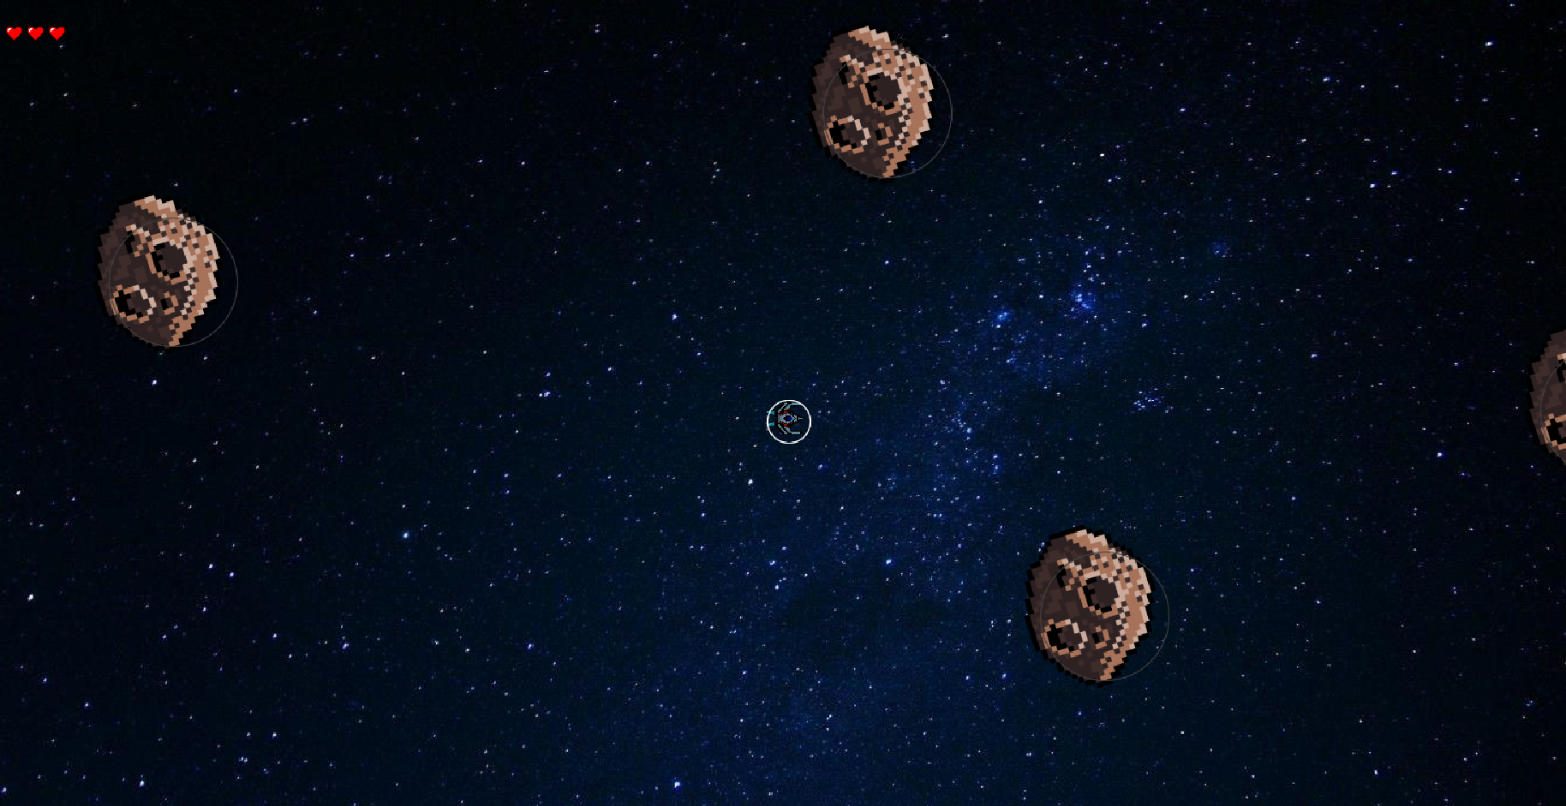
Level 1: Game Starts

Slide 9
How Player Collision Works
public boolean hitShip(Rock r) { if(shield == false && Math.sqrt(Math.pow( getX() - r.getX() , 2) + Math.pow( getY() - r.getY() , 2) ) < (20 + r.getScale()/2)) { return true; } return false; }
If a player’s shield is not turned on, we track the distance between the player’s center and the asteroid’s center. If that distance is less than the combined radius of the player and the asteroid, then a collision is detected and the player loses a life.

Slide 10
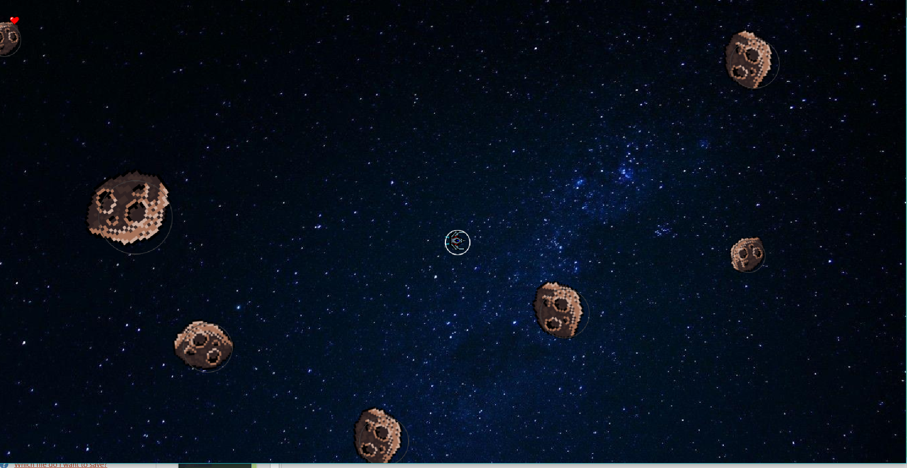
Level 1: Asteroid Splits

Slide 11
How the asteroid splits
if(hitRock == true) { hitRock = false; if(temp.getScale()>= 60) { numRocks += 2; rocks.add(new Rock((float) (temp.getOvalX() * 2 + temp.getScale()), (float) (temp.getOvalY() * 2 + temp.getScale()), 180 + temp.getAngle(), temp.getSize() / 1.5, temp.getSpeed()*1.4));
rocks.add(new Rock((float) (temp.getOvalX() * 2 + temp.getScale()), (float) (temp.getOvalY() * 2 + temp.getScale()), 90 + temp.getAngle(), temp.getSize() / 1.5, temp.getSpeed()*1.4)); } }
All the asteroids are stored in an ArrayList. When a collision between an asteroid and a laser is detected, we turned a Boolean variable hitRock to true and removed the original asteroid from the ArrayList. We stored the original asteroid’s properties in a temporary Asteroid object called temp. Then we added two more asteroids to the rocks ArrayList at its last location that is both smaller and moves faster.

Slide 12
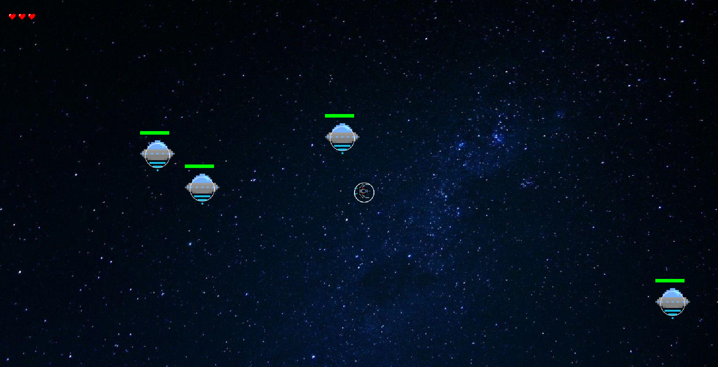
Level 2: Aliens

Slide 13
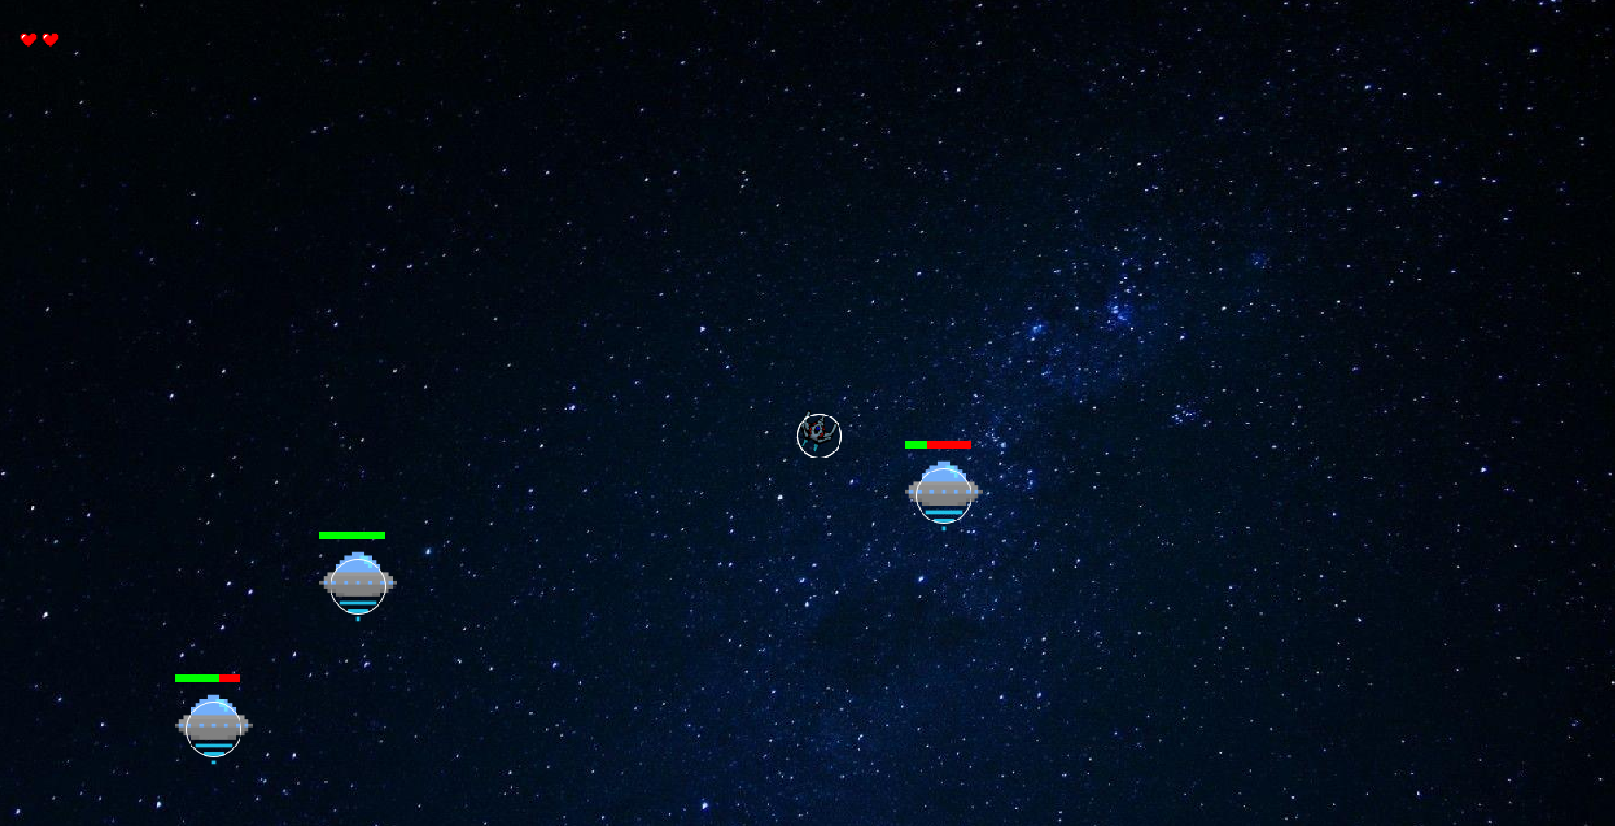
Level 2: Aliens get Hit

Slide 14
How Laser Collision works
public boolean hitAlien(Ammo shot) { if(Math.sqrt(Math.pow(shot.getX()-(ovalX+getScale()/2),2)+Math.pow(shot.getY()-(ovalY+getScale()/2),2))<getScale()/2) { gotHit = true; return true; } return false; }
We constantly track the location of each laser. When the laser’s coordinates are within the radius of either the player, alien, or asteroid, the laser is removed from the ArrayList and an action is performed. This action is either to remove a life from the alien or the player, or to split the asteroid.

Slide 15
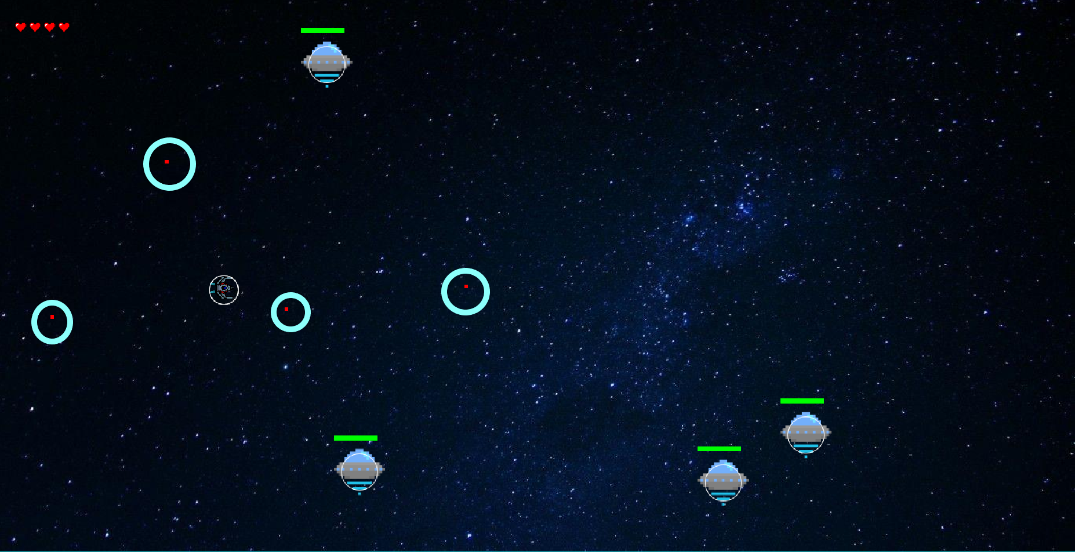
Level 2: Aliens shoot back

Slide 16
How the Aliens Track
double angleBW = Math.atan2(ship.getY()-spawnedAliens.get(i).getY(),ship.getX()- spawnedAliens.get(i).getX());
spawnedBullets.get(i).add(new Ammo((int)spawnedAliens.get(i).getX(), (int)spawnedAliens.get(i).getY(), 5, Math.toDegrees(angleBW), true));
Using arctan, we found the angle between the location of the aliens and the location of the player. The laser were added to an ArrayList, where a move function caused each laser to move in a direction until it goes off the screen, at which point the ArrayList removes it.

Slide 17
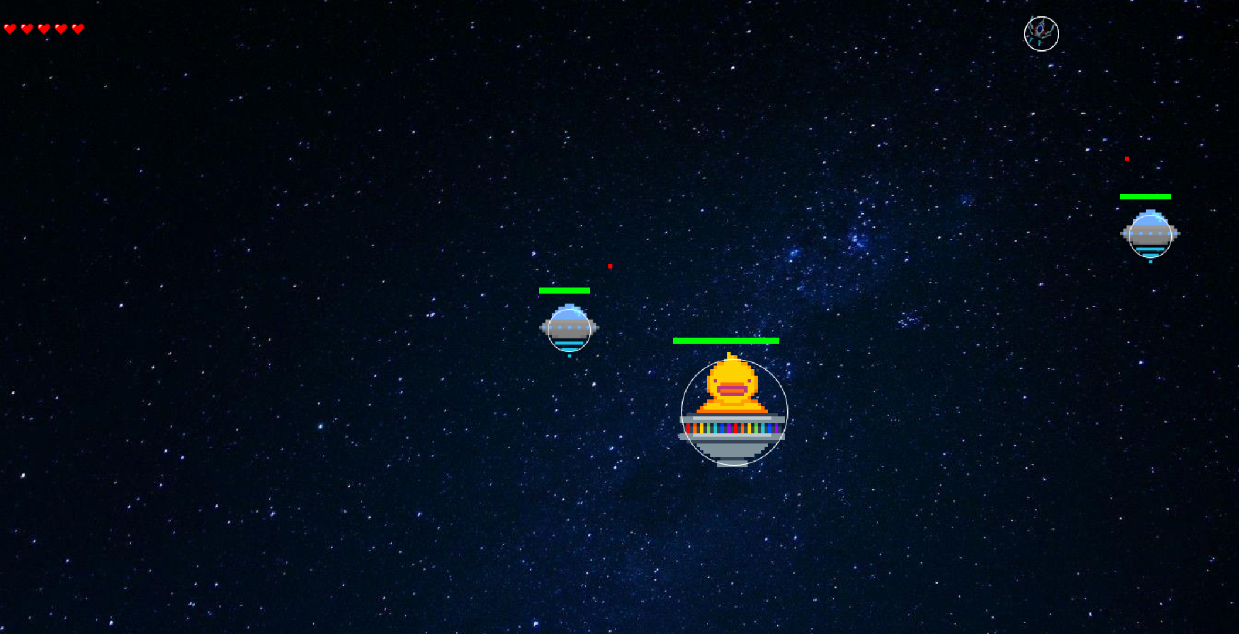
Level 3: Boss Alien spawns small aliens

Slide 18
How the Boss Alien spawns Small Aliens
if(bigAlien.getLives()>0 && System.currentTimeMillis()-lastSpawnAlienTime > 10000) { lastSpawnAlienTime = System.currentTimeMillis(); spawnedAliens.add(new AlienShip((float)bigAlien.getSpawnX(), (float)bigAlien.getSpawnY(),Math.random()*360, 2, 3)); spawnedBullets.add(new Bullets()); }
There are two conditions to making the boss alien spawn smaller aliens. Firstly, the boss alien must still be alive. We use the getLives() method to check that. Secondly, there must be a delay between the last time an alien was spawned and the next time. Thus, we used System.currentTimeMillis() and a variable lastSpawnAlienTime to make sure that an alien only spawns once every ten seconds

Slide 19
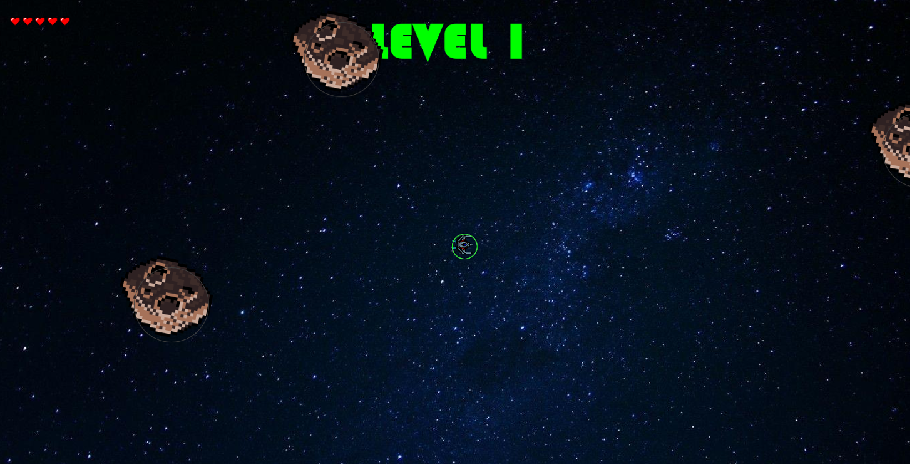
Quality of Life Updates
Two quality of life updates we added were level transitions and shields after dying or starting a new level. We did this using System.currentTimeMillis(); This tracks how long the program has been running. When a player dies or a new level is started, the current time is stored in a temporary variable. We then compare that variable to the current time. After that difference is larger than a certain value, the shield is turned off and the level sign goes away.

Slide 20
